Slide 1
C++ Part II
X52.9265-01
Yedidiah Solowiejczyk
Week#8
New York University
School
of
Professional and Continuous Studies
Nov 24, 2010
C++ Part II

Slide 2
Synopsis
Streams
  Understanding I/O streams
  I/O class hierarchy
  Overload the << and >> operators
  Format I/O by using ISO member functions
  Format I/O by using manipulators
  Open and close files
  Reading and writing text files
  Reading and writing binary files
  Additional file functions
  Random access files I/O
  Check I/O system status
Nov 24, 2010
C++ Part II

Slide 3

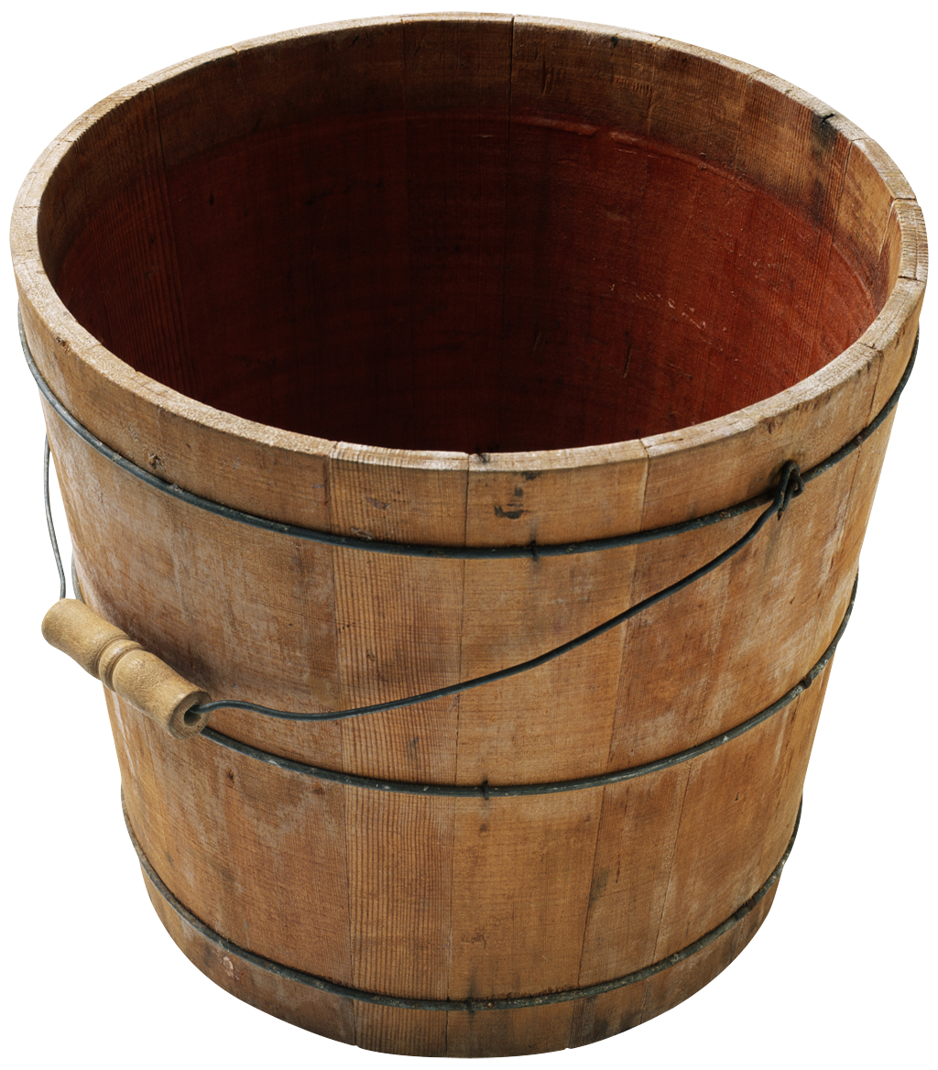
  Understand I/O streams
C++ does not define how data is written to the screen or file, nor how data is read into a program.
C++ provides libraries (i.e. iostream, ifstream, ofstream, etc) that handle the interface details on how data is read/written to files (includes displays, keyboards, etc) – platform independent
Encapsulation
  the iostream classes view the flow of data to/from program to screen as a stream of data
  streams encapsulate the interface details of getting the data to/from disk/screen
  After crating stream, program works with the stream and the stream sweats out the details.
Buffering
  Writing to disk ( or screen) is very time consuming.
  Data written to stream is buffered and it is sent to device when the buffer is full
Nov 24, 2010
C++ Part II

Slide 4
  Understand I/O streams
C++ I/O - based on the interface provided by various stream classes (objects) is configured in a complex hierarchy
  ios class – granddaddy of all stream classes
    formatting flags, error-status flags, operation mode
  istream & ostream classes – dedicated to input & output
    derived from ios class specializes in I/O stream behaviour
    get( ), getline( ), read( ), overloaded extractor >>
    put( ), write( ), overloaded insertion <<
  iostream class
    derived from istream and ostream classes provides I/O methods for writing to screen
  fstream class provides I/O to/from files
Nov 24, 2010
C++ Part II

Slide 5

  C++ Stream Classes Hierarchy
The stream classes are arranged in rather complex hierarchy.
iostream class is derived from both istream and ostream allowing bidirectional I/O
File manipulation using input/output operations is supported by
ifstream, ofstream and fstream
ios base class contains constants & member functions common to many I/O operations
istream contais get(), getline(), cin, >>
streambuf class contains the memory buffer into which data is read/written
Nov 24, 2010
C++ Part II

Slide 6
  ios Classes
The ios class is the granddaddy of all stream classes & contains the majority of features needed to operate C++ streams
The three most important features are:
  formatting flags
  error-status flags
  file operation mode
The ios class declares a bitmask enumeration called fmtflags in which the following values are defined.
These values are used to set or clear the format flags via ios member functions such as
  setf ( fmtflags )
  unsetf ( fmtflags )
  All output streams have setf() member
Example:
cout.setf(ios::fixed); // display data as fixed point
cout.setf(ios::showpoint);
Nov 24, 2010
C++ Part II

Slide 7
  ios Member Functions
ios class contains a number of functions that can be used to set the format flags and perform other tasks, namely;
  ch = fill( );
  fill (ch)
  p = precision( ) – get precision
  precision(p) – set precision
  w = width( ) - get current width
  width(w) - set width filed
  setf(flags) - set specified formatting flags
  unset (flags) - unset specified formatting flags
Example:
cout.width(4); // set file width to 4
cout.fill(‘*’); //set fill character to *
cout.seft(ios::left); //return to default decimal base
Nov 24, 2010
C++ Part II

Slide 8
  Understand I/O streams
Streams
  A stream is a flow of characters (or some other kind of data).
    Flow into a program is an input stream while flow out of a program is an output stream. Streams are connected using the overloaded << and >> operators.
  At the user level, a file consists of sequence of possible intermixed data (i.e. char, float, int, struct, and object).
  At lowest level, a file can be interpreted as a sequence, stream, of bytes (chars)
  I/O library manages the transfer of these bytes from/to user level to lowest level (Hardware)
  The iostream library pre-defines a set of operations for handling the reading and writing of built-in types
  The programmer can extend certain of these operations to handle class types
  The I/O operations are supported by hierarchy of standard input/output functions
Nov 24, 2010
C++ Part II

Slide 9
  C++ Streams
Fundamental point of the C++ I/O system is that it operates on streams.
A stream is an abstraction that either produces or consumes information.
A stream is linked to a physical device by the C++ I/O system.
All streams behave in the same manner, even if the actual physical devices they are linked to differ.
Common interface for all physical devices
A stream is a logical interface to a file
C++ defines “file” either as disk file, the screen, the keyboard, a port, a file on tape, and so on
A stream is linked to a file through an open operation.
A stream is disassociated from a file through a close operation.
Nov 24, 2010
C++ Part II

Slide 10
  C++ Streams
Two types of streams:
- text & binary.
Text stream is used with characters.
- When a text stream is being used, some character translations may take place.
i.e. the \n may be converted into a carriage return–linefeed sequence therefore there might not be a one-to-one correspondence between what is sent to the stream and what is written to the file.
Binary stream can be used with any type of data.
- No character translations will occur, and there is a one-to-one correspondence between what is sent to the stream and what is actually contained in the file.
- Some devices may not support all operations, such as
random-access operations
Nov 24, 2010
C++ Part II

Slide 11
  C++ Predefined Streams
C++ contains several predefined streams that are automatically opened when your C++ program begins execution.
  assuming that you include “using namespace std”
- cout – the ostream object associated with stdout (screen)
- cin - the istream object associated with stdin (keyboard)
- cerr - is linked to stderr (run time errors - unbuffered)
- clog - is linked to stderr (run time errors - buffered)
C++ also opens wide (16-bit) character versions of the standard streams called wcin, wcout, wcerr, and wclog.
- These streams exist to support languages, such as Chinese, that require large character sets.
By default, the C++ standard streams are linked to the console, but they can be redirected to other devices or files by your program.
They can also be redirected by the operating system.
  % MyProgram > MyProgram.txt – output data to file
  % MyProgram < MyProgram.dat – read data from file
Nov 24, 2010
C++ Part II

Slide 12
  C++ Stream Classes
- The I/O classes begin with a system of template classes
- Once a template class has been defined, specific instances of the template class can be created.
- The C++ I/O system is built upon two related, but different, template class hierarchies.
  ios class
  - contains constants and member functions for common input/output operations of all kinds
  istream and ostream are derived from ios which is dedicated to input/output (i.e. get( ), getline( ), read( ), put( ), write( ), >>, <<
  iostream is derived from istream and ostream (multiple inheritance) used for device that can be opened for read and write (e.g. disk files)
  streambuf class
    Manages the memory buffer into which data is read/written and the low-level member functions provide the capability to fill, empty, flush the buffer
Nov 24, 2010
C++ Part II

Slide 13
  Understand I/O streams
Old vs. Modern C++ I/O
  Currently there are two versions of the C++ I/O library in use:
    Old I/O library supported by <iostream.h>
    New I/IO library supported by <iostream>
      the vast majority of differences between the two occur beneath the surface, in the way that the libraries are implemented - not in how they are used
      the new I/O library contains a few additional features and defines some new data types
      the old-style I/O library was in the global namespace whereas the new-style library is in the std namespace.
      Old-style I/O library is now obsolete
Nov 24, 2010
C++ Part II

Slide 14
  ostream
ostream objects are stream objects used to write and format output as sequences of characters.
cout is an object of class ostream that represents the standard output stream.
Specific members functions are provided to perform these output operations, which can be divided in two main groups:
Formatted output
These member functions interpret and format the data to be written as sequences of characters. These type of operation is performed using member and global functions that overload the insertion operator (operator<<).
Unformatted output
output operations that write the data as it is, with no formatting adaptations. These member functions can write a determined number of characters to the output character sequence (put, write)
Nov 24, 2010
C++ Part II

Slide 15
  cout Member Functions
cout controls output to a stream buffer via:
setf(ios::showpos) ➔ + sign in non-negative
unsetf(ios::showpos)
setf(ios::showbase) ➔ prefix of numeric base
setf(ios::upercase ) …. … base::lowercase
unsetf(ios::upercase )
setf(ios_base::showpoint)
setf(ios::left) …ios::right
setf(ios::dec) …ios::hex
precision(n) ➔ number of digits after the decimal point
width(n) ➔ field width
flush( ) ➔ Flush the output buffer
setf(flag)
fill(c) ➔ Sets the character used to pad fixed field width
cout.width(10)
cout.flush( )
Nov 24, 2010
C++ Part II

Slide 16
  ostream class
the ostream class derived from ios performs output-specific activities or insertion
The following member functions are associated with ostream class:
  << - formatted insertion
  put(char) – insert char to stream
  flush( ) – flushes buffer contents & insert \n
  cout – standard output
  cerr – standard error output
  clog – standard printer output
cout.put(char)
cout.flush( )
Nov 24, 2010
C++ Part II

Slide 17
  cout Member Functions
Example
// output results using member functions
int i = 1023;
cout.fill('@');
cout.width(20);
cout.setf(ios_base::left, ios_base::adjustfield); cout.setf(ios_base::dec, ios_base::basefield);
cout << i << endl;
// change the precision to 6 digits
cout.precision(6);
Nov 24, 2010
C++ Part II

Slide 18
  istream
istream objects are stream objects used to read and interpret input from sequences of characters.
cin is an object of class ostream that represents the standard output stream.
Specific members functions are provided to perform these output operations, which can be divided in two main groups:
Formatted input
These functions extract data from a sequence of characters that may be interpreted and formatted to a value of a certain type.
Unformatted input
Most of the other member functions of the istream class are used to perform unformatted input, i.e. no interpretation made on the characters from the input.
These member functions can get a determined number of characters from the input character sequence (get, getline, peek, read, readsome), manipulate the get pointer i(ignore, seekg, tellg, unget)
Nov 24, 2010
C++ Part II

Slide 19
  cin Member Functions
cin controls input from a stream buffer via:
>> ➔ formatted extraction
get(ch) ➔ extract one character into ch
get(str) ➔ extract characters into array str untin NULL
get(str, MAX) ➔ same as above until MAX
get(str, DELIM) ➔ same as above until DELIM
getline(str, MAX, DELIM) –
putback(ch) ➔ insert last character back into stream
peek(ch) ➔ read one character and leave in stream
good( ) ➔ returns true if all is OK; no flags set
ignore( int len, ‘\n’) ➔ read & remove 10 chars including ‘\n’
cin.get(ch)
cin.getline(str,MAX<DELIM)
Nov 24, 2010
C++ Part II

Slide 20
  cin Member Functions
Example
// istream getline
#include <iostream>
using namespace std;
int main ()
{
char name[256], title[256];
cout << "Enter your name: ";
cin.getline (name,256);
cout << "Enter your favourite movie: ";
cin.getline (title,256);
cout << name << "'s favourite movie is " << title;
return 0;
}
Nov 24, 2010
C++ Part II

Slide 21
  Input Using cin
The global object cin responsible for input is made available to C++ program via <iostream>
cin has an overloaded extraction operator >> which allows to write whatever data it contains into a local variable (someVariable)
the overloaded operator for cin allows to extract a great variety of parameters, namely; int &, short &, long &, float &, double &, char &, char *, …etc,
int someVariable;
  cin >> someVariable; // type of variable is assessed invoking
  istream & operator>> (int &); //prototype
  Since the return value of cin is a reference to an istream object, one can cascade various inputs
  ( (cin >> varOne) >> varTwo) >> varThree;
Nov 24, 2010
C++ Part II

Slide 22
  Other Member Functions of cin
Single Character Input
- the overloaded member function get( ) can also be used with cin to get one character into a char varName
cin >> varName; // skips leading white spaces but leaves ‘\n’
cin.get( varName );
This returns the value of of the char read or return EOF if end of file is reached.
cin.get( ) >> varNameOne >> varNameTwo; //illegal
Example:
char c;
while( (ch = cin.get(ch) != EOF) ) // cntrl+ Z(DOS), cntrl+ D(UNIX)
cout << “ch = “ << ch << endl;
cout << “Done” << endl;
Nov 24, 2010
C++ Part II

Slide 23
  Other get( ) Member Functions of cin
Single Character Input
- the member function get(char varName) can also be used with cin to get one character into a char varName
- the return value is an iostream object so one can concatenate
cin.get(varName1).get(varName2). get(varName3);
cin.get( ) >> varName;
String Input
char String[32];
cin.get(char *, int MAX, char DELIM);
  cin.get(String, 32, ‘\n’); // read 31 chars & NULL terminate
  ‘\n’ will remain in the buffer
  cin.getline(String, 32, ‘\n’); // read 31 chars & NULL terminate
  ‘\n’ is thrown away
Extracts characters from the stream and stores them as a c-string into the array beginning at string – stops at ‘\n’
Nov 24, 2010
C++ Part II

Slide 24
  Other get( ) Member Functions of cin
cin.ignore(int Num, char DELIM ) – allows user to ignore remaining chars on a line until EOL or EOF
cin.ignore(32, ‘\n’); // read up to 32 char & throw out
// or until you reach ‘\n’ & throw
char c = cin.peek( ) – reads one character and leave it in the stream
cin.putback(char ) – put last character read into stream & decrements internal pointer
Example:
while( cin.get(ch) ){
if(ch == ‘!’) // if ! found substitute $
cin.putback(‘$’);
else
cout << ch;
}
Nov 24, 2010
C++ Part II

Slide 25
  Overloading the I/O Operators
Up until now, when a program needed to output or input the data associated with a class, member functions were created whose only purpose was to output or input the class’ data.
In the language of C++, the << operator is referred to as the insertion operator because it inserts data into a stream.
Likewise, the >> operator is called the extraction operator because it extracts data from a stream.
The operator << and operator >> can be overloaded as member functions of a class which become responsible for outputting and inputting the member data in a class
In <iostream>, the insertion and extraction operators are overloaded for all of the C++ built-in types, meaning that
int X = 10; float Y = 12.5; char c = ‘A’;
cout << X << “ “ ; cout << Y << “ “ ; cout << c << endl;
10 12.500000 A
The insertion and extraction overloaded operator can be trained to output/input user-defined objects
Nov 24, 2010
C++ Part II

Slide 26
  Overloading the I/O Operators
The << operator is already overloaded:
    It is a bitwise left-shift operator
    It is C++ an output operator when cout appears on lhs
    For output you need to include <iostream>
    <iostream> includes overloaded operator function that looks like:
    friend ostream & operator<<(ostream &c, char * pSource);
    friend ostream & operator<<(ostream &c, int source);
    friend ostream & operator<<(ostream &c, char source);
      etc
      operator<<( ) is a friend of the class thus requires two arguments
      Overloaded <<( ) function returns a output stream object
        reference to cout object
    cout << “hello” << “world”;
    (cout << “hello”) << “world”;
Remember that cout is a object of type ostream
Nov 24, 2010
C++ Part II

Slide 27
  Overloading the I/O Operators
Creating Inserters
Example:
class Point{
public:
int x, y;
Point ( int a, int b) : x(a), y(b){ }
friend & ostream operator<<(ostream & Out, Point & P);
friend & istream operator >>(istream & In, Point & P);
};
ostream & operator<<(ostream & Out, Point P){
Out << “P.x = “ << P.x ; //formatting the member data for output
Out << “P.y = “ << P.y << endl;
return Out;
}
Overloading Extractors
Istream & operator>>(istream & In, Point & P){
In >> P.x >> P.y ;
return In;
}
Nov 24, 2010
C++ Part II

Slide 28
  Output Using cout
The global object cout responsible for output and is made available to C++ program via <iostream>
cout has an overloaded insertion operator << which allows to write whatever data it contains into a local variable (someVarialbe)
the overloaded operator for cout allows to extract a great variety of parameters, namely; int &, short &, long &, float &, double &, char &, char *, …etc,
cout is provided with the following counterpart member functions for outputting
  << Formatted insertion for all basic and overloaded types
  put(ch) Insert character ch into stream
  flush( ) flush buffer and insert ‘\n’
  write(string, SIZE) Insert SIZE chars into array string)
Examples:
char C = ‘A’;
String S[32 ] =“To be or not to be….”;
cout.put ( C );
cout.write(S, 16);
cout .flush( );
Nov 24, 2010
C++ Part II

Slide 29
  Manipulators
Manipulators are formatting instructions inserted directly into the streams
Manipulators come in two flavors, those that take arguments and those that do not take arguments
Non-Argument Manipulators Manipulators with Arguments
dec Use base 10. setw( N ) – set width of output to N
  oct Use base 8. setfill( ) – set fill character for output
  hex Use base 16. setprecision( N ) - # digits
  endl insert \n and flush setiosflags( ) – set specified flags
  ends insert NULL to string resetflags( ) – Clear specifed flags
  flush flush the output stream
  lock lock the handle
  unlock unlock the hadle
Example:
cout << hex << var;
cout << flush; //flush the stream and insert newline
cout.unset(ios::hex); //return to default decimal base
cout.width(4) ➔ setw(4)
cout.setf( iios::???) ➔ setiosflags( ios::???)
Nov 24, 2010
C++ Part II

Slide 30
  Manipulators
Manipulators are defined as:
"A function called in nontraditional way"
  Can have arguments
  Placed after insertion operator
  Do same things as member functions(just differently)
Common to use both "together"
setw( ) & setprecision( ) are in
<iomanip> and std namespace
setw() affects only NEXT output value
  Must include setw() manipulator before each
  outputted item to affect all !!!!!!
  cout << "Start" << setw(4) << 10
  << setw(4) << 20 << setw(6) << 30;
Nov 24, 2010
C++ Part II

Slide 31
  Manipulators & Flags
setprecision( ) manipulator:
cout.setf(ios::fixed | ios::showpoint);
cout << "$" << setprecision(2) << 10.3 << " ” << "$" << 20.5
Results in: $10.30 $20.50
Saving Flag Settings
  - Flag settings "stay" until changed
  - Precision and setf flags can be saved and restored
    Function precision() returns current setting
    if called with no arguments
    Member function flags() provides similar capability
Example:
int precisionSetting = outStream.precision(); //save present values
long flagSettings = outStream.flags();
outStream.setf(ios::fixed | ios::showpoint); // reset values
outStream.precision(2);
// do whatever you want
outStream.precision(precisionSetting);
outStream.flags(flagSettings);
Nov 24, 2010
C++ Part II

Slide 32
  ios Class§
The ios class is the granddaddy of all stream classes & contains the majority of features needed to operate C++ streams
The three most important features are:
  formatting flags
  error-status flags
  file operation mode
Formatting Flags are a set of enum definitions in ios that act as
  on/off switches that specify various aspects of I/O format and operation
  dec Use base 10.
  oct Use base 8.( cout.setf (ios::oct); )
  hex Use base 16.
  left Align left. (cout.setf (ios::left); )
  right Align right.
  scientific Outputs float values in scientific format
  showbase Encodes base on integer output.
  showpoint Include decimal point in output.
  showpos Include positive (+) sign in output.
  skipws Skip white space (spaces and tabs).
  uppercase Forces upper case output.
§ see IoFormat.cpp
//left justify text output
cout.unsetf(ios::left)
cout.setf(ios:::left);
//return to default
cout.unsetf(ios::left)
Nov 24, 2010
C++ Part II

Slide 33
  ios Class prototype
class ios {
public:
// stream status bits
enum io_state {
goodbit = 0x00, // no bit set: all is ok
eofbit = 0x01, // at end of file
failbit = 0x02, // last I/O operation failed
badbit = 0x04, // invalid operation attempted
hardfail = 0x80 // unrecoverable error
};
// stream operation mode
enum open_mode {
in = 0x01, // open for reading
out = 0x02, // open for writing
ate = 0x04, // seek to eof upon original open
app = 0x08, // append mode: all additions at eof
trunc = 0x10, // truncate file if already exists
nocreate = 0x20, // open fails if file doesn't exist
noreplace= 0x40, // open fails if file already exists
binary = 0x80 // binary (not text) file
};
// stream seek direction
enum seek_dir { beg=0, cur=1, end=2 };
// formatting flags
enum {
skipws = 0x0001, // skip whitespace on input
left = 0x0002, // left-adjust output
right = 0x0004, // right-adjust output
internal = 0x0008, // padding after sign or base indicator
dec = 0x0010, // decimal conversion
oct = 0x0020, // octal conversion
hex = 0x0040, // hexadecimal conversion
showbase = 0x0080, // use base indicator on output
showpoint = 0x0100, // force decimal point (floating output)
uppercase = 0x0200, // upper-case hex output
showpos = 0x0400, // add '+' to positive integers
scientific= 0x0800, // use 1.2345E2 floating notation
fixed = 0x1000, // use 123.45 floating notation
unitbuf = 0x2000, // flush all streams after insertion
stdio = 0x4000, // flush stdout, stderr after insertion
boolalpha = 0x8000 // insert/extract bools as text or numeric
};
static const long adjustfield;
static const long basefield;
static const long floatfield;
ios (streambuf *);
virtual ~ios ();
static long bitalloc ();
int bad ();
void clear (int = 0);
int eof ();
int fail ();
char fill ();
char fill (char);
long flags ();
long flags (long);
int good ();
long & iword (int);
int precision ();
int precision (int);
void * & pword (int);
streambuf * rdbuf ();
int rdstate ();
long setf (long _setbits, long _field);
long setf (long);
static void sync_with_stdio ();
ostream * tie (ostream *);
ostream * tie ();
long unsetf (long);
int width ();
int width (int);
static int xalloc ();
operator void * ();
int operator ! ();
};
Nov 24, 2010
C++ Part II

Slide 34
  File Input / Output
Input/output file stream class hierarchy
ios_base ➔ ios ➔ istream ➔ iostream ➔ fstream
➔ ostream ➔
fstream provides an interface to read and write data from files as input/output streams.
The objects of this class maintain internally a pointer to a filebuf object that can be obtained by calling member rdbuf.
The file to be associated with the stream can be specified either as a parameter in the constructor or by calling member open.
After all necessary operations on a file have been performed, it can be closed (or disassociated) by calling member close. Once closed, the same file stream object may be used to open another file.
The member function is_open can be used to determine whether the stream object is currently associated with a file
Nov 24, 2010
C++ Part II

Slide 35
  fstream
fstream provides an interface to read and write data from files as input/output streams.
The objects of this class contain:
PMFs
  constructor - optionally open file (constructor member)
  rdbuf - Get the associated filebuf object (PMF)
  is_open - Check if a file is open (PMF)
  open - Open file (PMF)
  close - Close file (PMF)
Members inherited from istream
  operator>> Extract formatted data (PMF)
  get Get unformatted data from stream (PMF)
  getline Get line from stream (PMF)
  ignore Extract and discard characters (PMFs)
  peek Peek next character (PMF)
  read Read block of data (PMF)
  putback Put character back (PMF)
  unget Decrement get pointer (PMF)
  tellg Get position of the get pointer. (PMF)
  seekg Set position of the get pointer (PMF)
Nov 24, 2010
C++ Part II

Slide 36
  fstream (cont)
fstream provides an interface to read and write data from files as input/output streams.
Members inherited from ostream
  operator<< Insert data with format (PMF)§
  put Put character (PMF)
  write Write block of data (PMF)
  tellp Get position of put pointer (PMF)
  seekp Set position of put pointer (PMF)
  flush Flush output stream buffer (PMF)
Member functions inherited from ios
  good Check istate of the stream is good for i/o operations.
  eof Check if eofbit is set (PMF)
  fail Check if either failbit or badbit is set (PMF)
  bad Check if badbit is set (PMF)
  rdstate Get error state flags (PMF)
  setstate Set error state flag (PMF)
  clear Set error state flags (PMF)
  fill Get/set the fill character (PMF)
Member functions inherited from ios_base
  flags, setf, unsetf, precision, width, etc
§ - PMF: public member function
Nov 24, 2010
C++ Part II

Slide 37
  File Input / Output
A file is opened by linking it to a stream.
As you know, there are three types of file streams:
  input,
  output,
  input/output.
To open an input stream, it must be declared as a class ifstream.
To open an output stream, it must be declared as class ofstream.
A stream that will be performing both input and output operations must be declared as class fstream.
Declared Streams
ifstream fin;
oftream fout;
fstream finout;
Opening Files
fin.open( char * InfileName, FileMode, Share);
fout.open( char *OutfileName , FileMode, Share) ;
finout.open(char * InOutFileName, FileMode1 | FileMode2);
ios::FileMode describes different modes of opening file (Read, Write, Append, etc) and filebuf::Share describes sharing capabillities
Nov 24, 2010
C++ Part II

Slide 38
  File Input / Output Libraries
fstream provides an interface to read and write data from files as input/output streams.
To allow both file input and output in your program you need:
#include <fstream>
using namespace std;
OR
#include <fstream>
using std::ifstream;
using std::ofstream;
Public Member Functions:
  constructor - Construct object and optionally open file (constructor member)
  rdbuf Get the associated filebuf object (PMF)
  is_open - Check if a file is open (PMF)
  open - Open file (PMF)
  close - Close file (PMF)
Member functions inherited from ios
good()
eof()
Nov 24, 2010
C++ Part II

Slide 39
  File Names
Files have two names in programs
  External file name
    Also called "physical file name"
    Like "infile.txt”
    Used only once in program (to open)
  Stream name
    Also called "logical file name"
    Program uses this name for all file activity (e.g. read, write, etc)
Stream must be declared like any other class variable:
ifstream inStream; //stream names
ofstream outStream;
Must then "connect" to file:
inStream.open("infile.txt"); // "opening the file"
  // Uses member function open
  // Can specify complete pathname
Nov 24, 2010
C++ Part II

Slide 40
  Streams Usage
Stream must be declared like any other class variable:
ifstream inStream;
ofstream outStream;
Must then "connect" to file:
inStream.open("infile.txt"); // "opening the files”
outStream.open("outfile.txt");
Output stream:
int oneNumber, anotherNumber;
inStream >> oneNumber >> anotherNumber;
Output stream:
outStream << "oneNumber = " << oneNumber
<< " anotherNumber = "
<< anotherNumber;
Nov 24, 2010
C++ Part II

Slide 41
  File Input / Output Modes
Declaring Streams
ifstream fin; // declare a input stream
oftream fout; //declare output stream
fstream finout; //declare input/output stream
Opening Files (connect streams with files)
fin.open(“input file name”, ios::in, filebuf::openprot);
fout.open(“output file name”, ios::trunc, filebuf::openprot );
finout.open(“file name”, ios::in | ios::out);
File Modes
ios::app - append to the end of existing file
ios::ate - places at end of file but can write everywhere
ios::binary - open file as binary file (vs. default text mode)
ios::in - read mode
ios::out - output mode
ios:trun - causes existing file to be truncated
ios::noncreate – if file does not exist, open fails
ios::nonreplace - if file already exists then open fails
Default values
Nov 24, 2010
C++ Part II

Slide 42
Checking File Open/Close Success
File opens could fail
  If input file doesn’t exist
  No write permissions to output file
  Unexpected results
Member function fail()
  Place call to fail() to check stream operation success
  inStream.open("stuff.txt");
  if (inStream.fail() )
  {
  cout << "File open failed.\n";
  exit(1);
  }
File closes could also fail
inStream.close( );
On failure, the failbit internal state flag is set
check bit with fail( ) ios member function
Nov 24, 2010
C++ Part II

Slide 43
  File Input / Output Modes
Appending Mode:
Standard open operation begins with empty file
  Even if file exists → contents are destroyed
  Open for append:
  ofstream outStream;
  outStream.open(”OutFile.txt", ios::app);
    If file doesn’t exist → creates it
    If file exists → appends to end
Protecting Mode:
I want to open a file only if it does not exits
ofstream outStream;
outStream.open(”OutFile.txt", ios::noreplace);
I want to open file only if exists
ofstream outStream;
outStream.open(”OutFile.txt", ios::nocreate);
Nov 24, 2010
C++ Part II

Slide 44
File Output/Input Example§
#include <fstream>
#include <iostream>
using namespace std;
class Point{
public:
int x, y;
Point(int a, int b):x(a), y(b){}
~Point( ){}
friend ostream& operator<<(ostream & os, Point & P);
};
int main( ){
Point P1(1,1), P2(2,2), P3(5,5);
cout << ”P: ” << P1 << P2 << P3 << endl;
char File[32] = "File.txt"; //File Name
ifstream fin; //declare streams
ofstream fout;
fout.open(File, ios::trunc); //open file
if(!fout) {
cout << "Unable to open file: \n" << File;
exit(1); }
§ - see IoPoint.cpp
fout.write( (char *)&P1, sizeof(Point) );
fout.write( (char *)&P2, sizeof(Point) );
fout.write( (char *)&P3, sizeof(Point) );
fout.close( );
fin.open(File, ios::in); ; //open file
if(!fin) {
cout << "Unable to open file: " << File << endl;
exit(1); }
fin.read( (char *)&P3, sizeof(Point) ); // reverse
fin.read( (char *)&P2, sizeof(Point) );
fin.read( (char *)&P1, sizeof(Point) );
fin.close( );
cout << ”P: ” << P1 << P2 << P3 << endl;
return 0;
}
P.x = 1 P.y = 1
P.x = 2 P.y = 2
P.x = 5 P.y = 5
P.x = 5 P.y = 5
P.x = 2 P.y = 2
P.x = 1 P.y = 1
Nov 24, 2010
C++ Part II

Slide 45
  Closing and Flushing Files
Closing Files
- When program completed inputting or outputting data
    Disconnects stream from file
    inStream.close( ); // Note no arguments
    outStream.close( );
  Files automatically close when program ends
Flushing Files
- Output often "buffered”
  Temporarily stored before written to file
  Written in "groups” (Blocks)
Occasionally might need to force writing:
Member function flush, for all output streams
  All buffered output is physically written
  outStream.flush();
      Closing file automatically calls flush()
Nov 24, 2010
C++ Part II

Slide 46
  Alternative Syntax for File Opens
Alternative Open File
ifstream inStream;
inStream.open("infile.txt"); //use member function
OR
ifstream inStream;
ifstream inStream("infile.txt"); //use constructor
Alternative File Failures
File opens could fail
    If input file doesn’t exist
    No write permissions to output file
    Unexpected results
  inStream.open(”FILE.txt");
  if (inStream.fail( ) ) // if( !inStream) // if not false ➔ true
  {
  cout << "File open failed.\n";
  exit(1);
  }
Nov 24, 2010
C++ Part II

Slide 47
  Binary I/O
Storage of raw data is more efficient in Binary Mode
  Data is stored exactly as represented in RAM rather than strings of characters
  write( ) of ofstream & read( ) member functions of ifstream
  think of data as just bytes (type char) thus when storing integer buffers some casting of pointers must be done
  - Recall that the default mode is “text”
Example:
int buf[80];
ofstream os(“Out.dat”, ios::binary);
os.write( reinterpet_cast<char *>(buf), MAX*sizeof(int) );
os.close( );
memset(buf, 0, 80); //clear buffer memory
ifstream is(“Out.dat”, ios::binary);
is.read(reinterpret_cast<char *>(buf), MAX*sizeof(int) );
Nov 24, 2010
C++ Part II

Slide 48
  Random Access to Files§
Sequential Access
  Most commonly used
Random Access
  Rapid “random” access to records (Perhaps very large database)
  Use fstream objects ( Input and output files )
Files have two file pointers associated with each stream
  Specify the bye position where reading/writing will take place
Opens same as istream or ostream
  fstream rwStream;
  rwStream.open("stuff", ios::in | ios:: out); //open for read/write
Move about in file
// Sets the position of the get & put pointers
ostream& seekp ( streampos pos );
ostream& seekp ( streamoff off, ios_base::seekdir dir );
//seekdir dir ➔ ios_base::beg, ios_base::cur, ios_base::end
ios_base::endistream& seekg ( streampos pos );
istream& seekg ( streamoff off, ios_base::seekdir dir );
//seekdir dir ➔ ios_base::beg, ios_base::cur, ios_base::end
long stuff.tellg( ) – Returns the absolute position of the get pointer.
§ - see IoFolk.cpp
Nov 24, 2010
C++ Part II

Slide 49
  Status Error Member Functions§
When opening a file results in a failure one can examine the output of the following member functions
  clear( ) - clears the error status
  eof( ) - returns True if EOF is reached
  fail( ) - returns True if Error occurred
  good( ) - returns True if the last I/O operation worked
Example:
ifstream file;
file.open( “test.txt”);
if( !file)
{
cout << “ Cannot Open file:,,,,”;
cout << “\ngood” << file.good( ); // bit encoding of errors
cout << “\neof” << file.eof( );
cout << “\nfail” << file.fail( );
cout << “\nbad” << file.bad( );
}
  § - see IoFolk.cpp
Nov 24, 2010
C++ Part II

Slide 50
  Character I/O with Files
All cin/cout character I/O member functions work the same for files:
  get, getline
  put, putback,
  peek, ignore
Checking for end of file
  Member function eof() – Method #1
  inStream.get(next);
  while (!inStream.eof()) // eof() member function returns bool
  {
  cout << next;
  inStream.get(next); //Reads character until file ends
  }
  Method #2
    double next, sum = 0;
    while (inStream >> next) // Expression true if read successful
    sum = sum + next;
Nov 24, 2010
C++ Part II

Slide 51
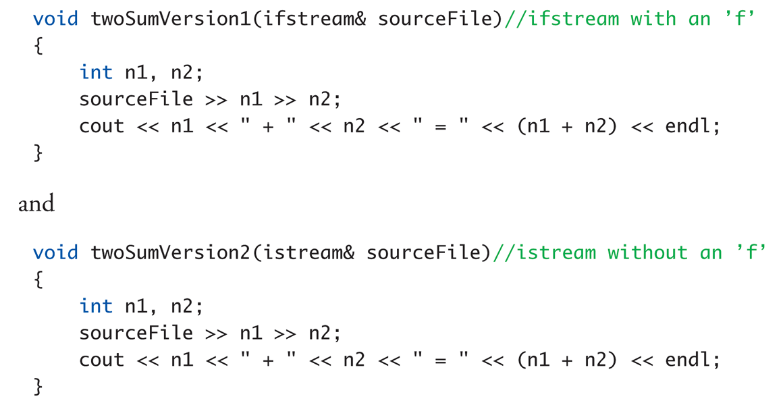
  Stream Class Inheritance
Inheritance
If D is derived class of class B then
  All objects of type D are also of type B
  e.g., A convertible is also an automobile
Regarding streams:
  An ifstream object is also an istream object
  Should use istream objects for parameters
    More objects can be plugged in!
Nov 24, 2010
C++ Part II

Slide 52
  Stream Class Inheritance
Example:
Considering previous functions:
twoSumVersion1(fileIn); // Legal!
twoSumVersion1(cin); // ILLEGAL!
  Because cin is not of type ifstream!
twoSumVersion2(fileIn); // Legal!
twoSumVersion2(cin); // Legal!
  More versatile
  istream parameter accepts both objects
Nov 24, 2010
C++ Part II

Slide 53
  Summary
Streams connect to files with open operations
Member function fail() checks successes
Stream member functions format output
  e.g., width, setf, precision
  Same usage for cout (screen) or files
istream (no "f") parameters accept cin or ifstream objects as arguments
ostream (no "f) parameters accept cout or ofstream objects as arguments
Member function eof
  Used to test for end of input file
Nov 24, 2010
C++ Part II

